Slide 1

IT Agile Transformation
Serasa Experian - Brazil
Notes:
our main purpose is to expand the adoption of agile practices in a sustainable way, supporting Experian to create a more participatory and collaborative environment guided by the princeples and values of the Agile Manisfeto (I will talk about it later in the presentation). And I'm here today to share with you somethings that we have changed and/or adapted during these process.

Slide 2


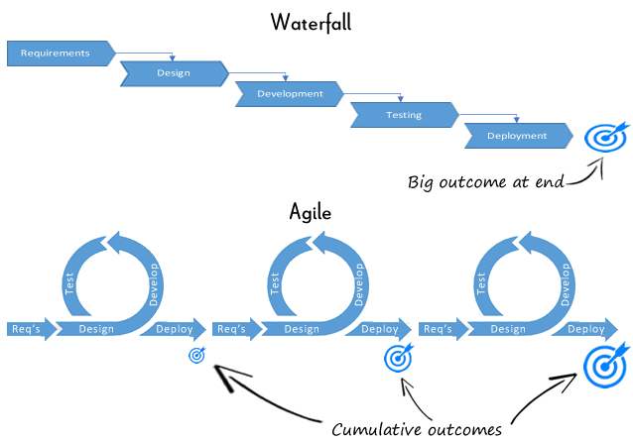
IT Agile Transformation (Before - AS IS)
Requirements
Waterfall
Design
Development
Testing
Deployment
Agile

Slide 3


The Agile Transformation Iceberg
20 %
Process
Tools
Roles
CULTURE
80 %

Slide 4
Agile Manifesto – Principles
delivery VALUE as priority
delivery WORKING software
work as a SELF ORGANIZED team with AUTONOMY
BEING AGILE IS...
IMPROVE yourself CONSTANTLY
working TOGETHER and MOTIVATED
ADEPT yourself to the CHANGES
http://agilemanifesto.org/

Slide 5
Agile Manifesto – Values
Individuals and interactions over processes and tools.
Working software over comprehensive documentation.
Customer collaboration over contract negotiation.
Responding to change over following a plan.
http://agilemanifesto.org/

Slide 6




What have we changed here?
Tribe
Tribe
Squad
Autonomous as possible
Self organized
Multidisciplinary
Tribes
Same domain of subject
Organized for minimun interdependency
Chapters
Specialists – not full time allocated
Guild
Community of interest
Cross teams
Chapter
TL
TL
Squad
Squad
Squad
Squad
Squad
CoE
PO
PO
PO
PO
PO
AM
AM
AM
Guild
AM
AM

Slide 7
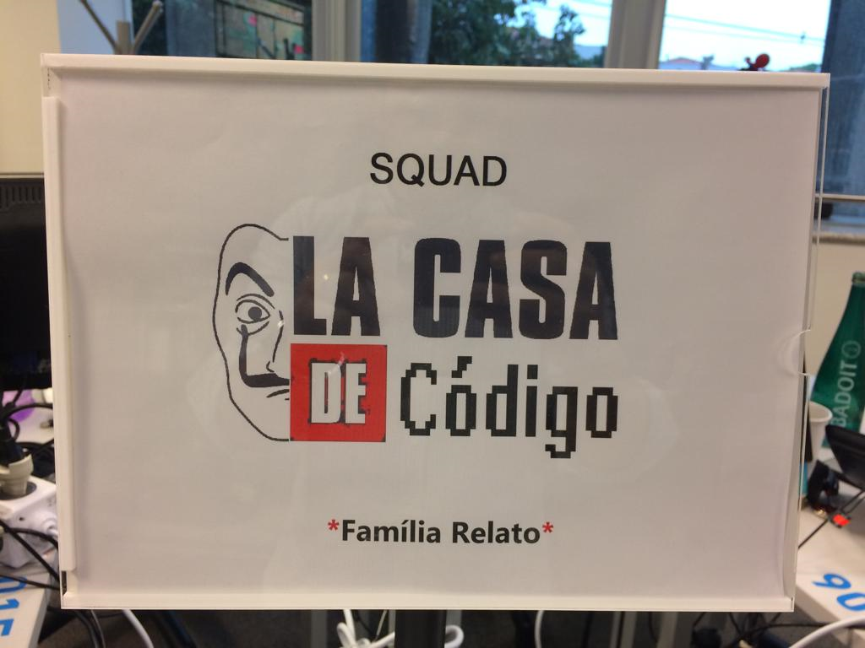
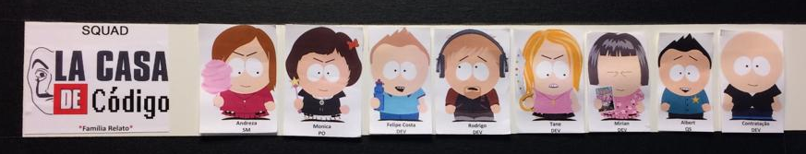
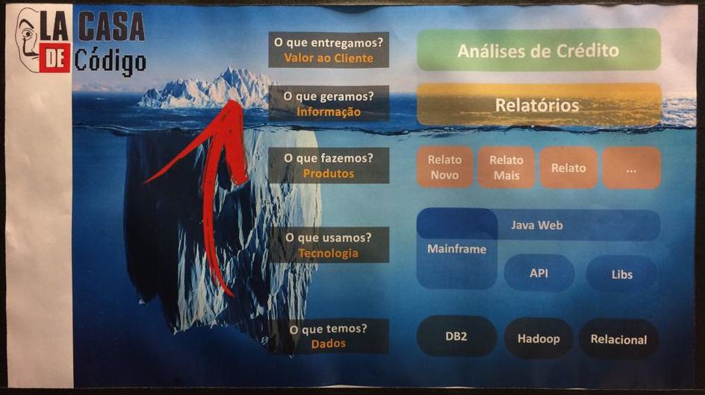
What have we changed here?

Slide 8
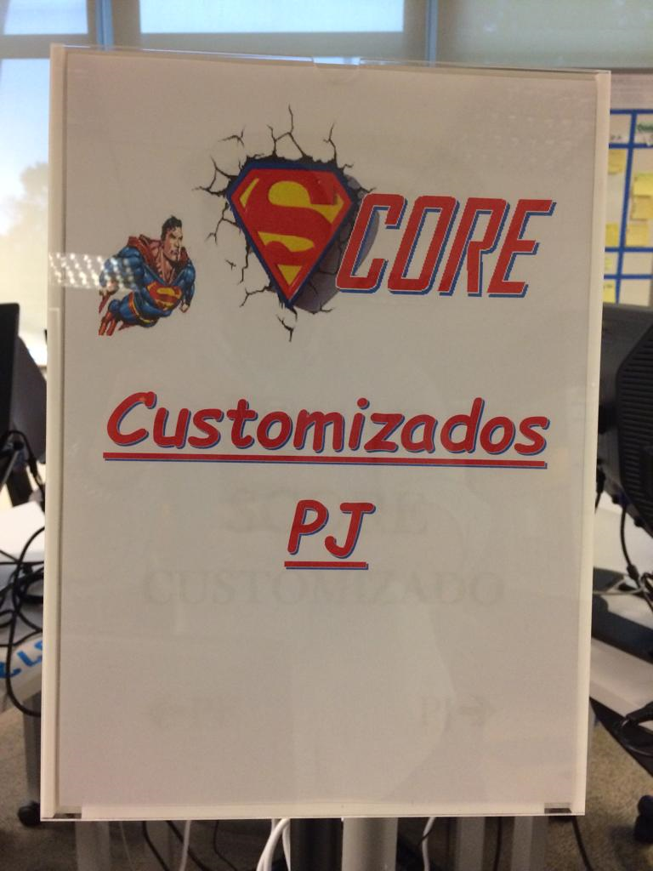
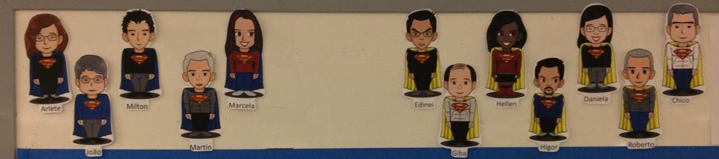
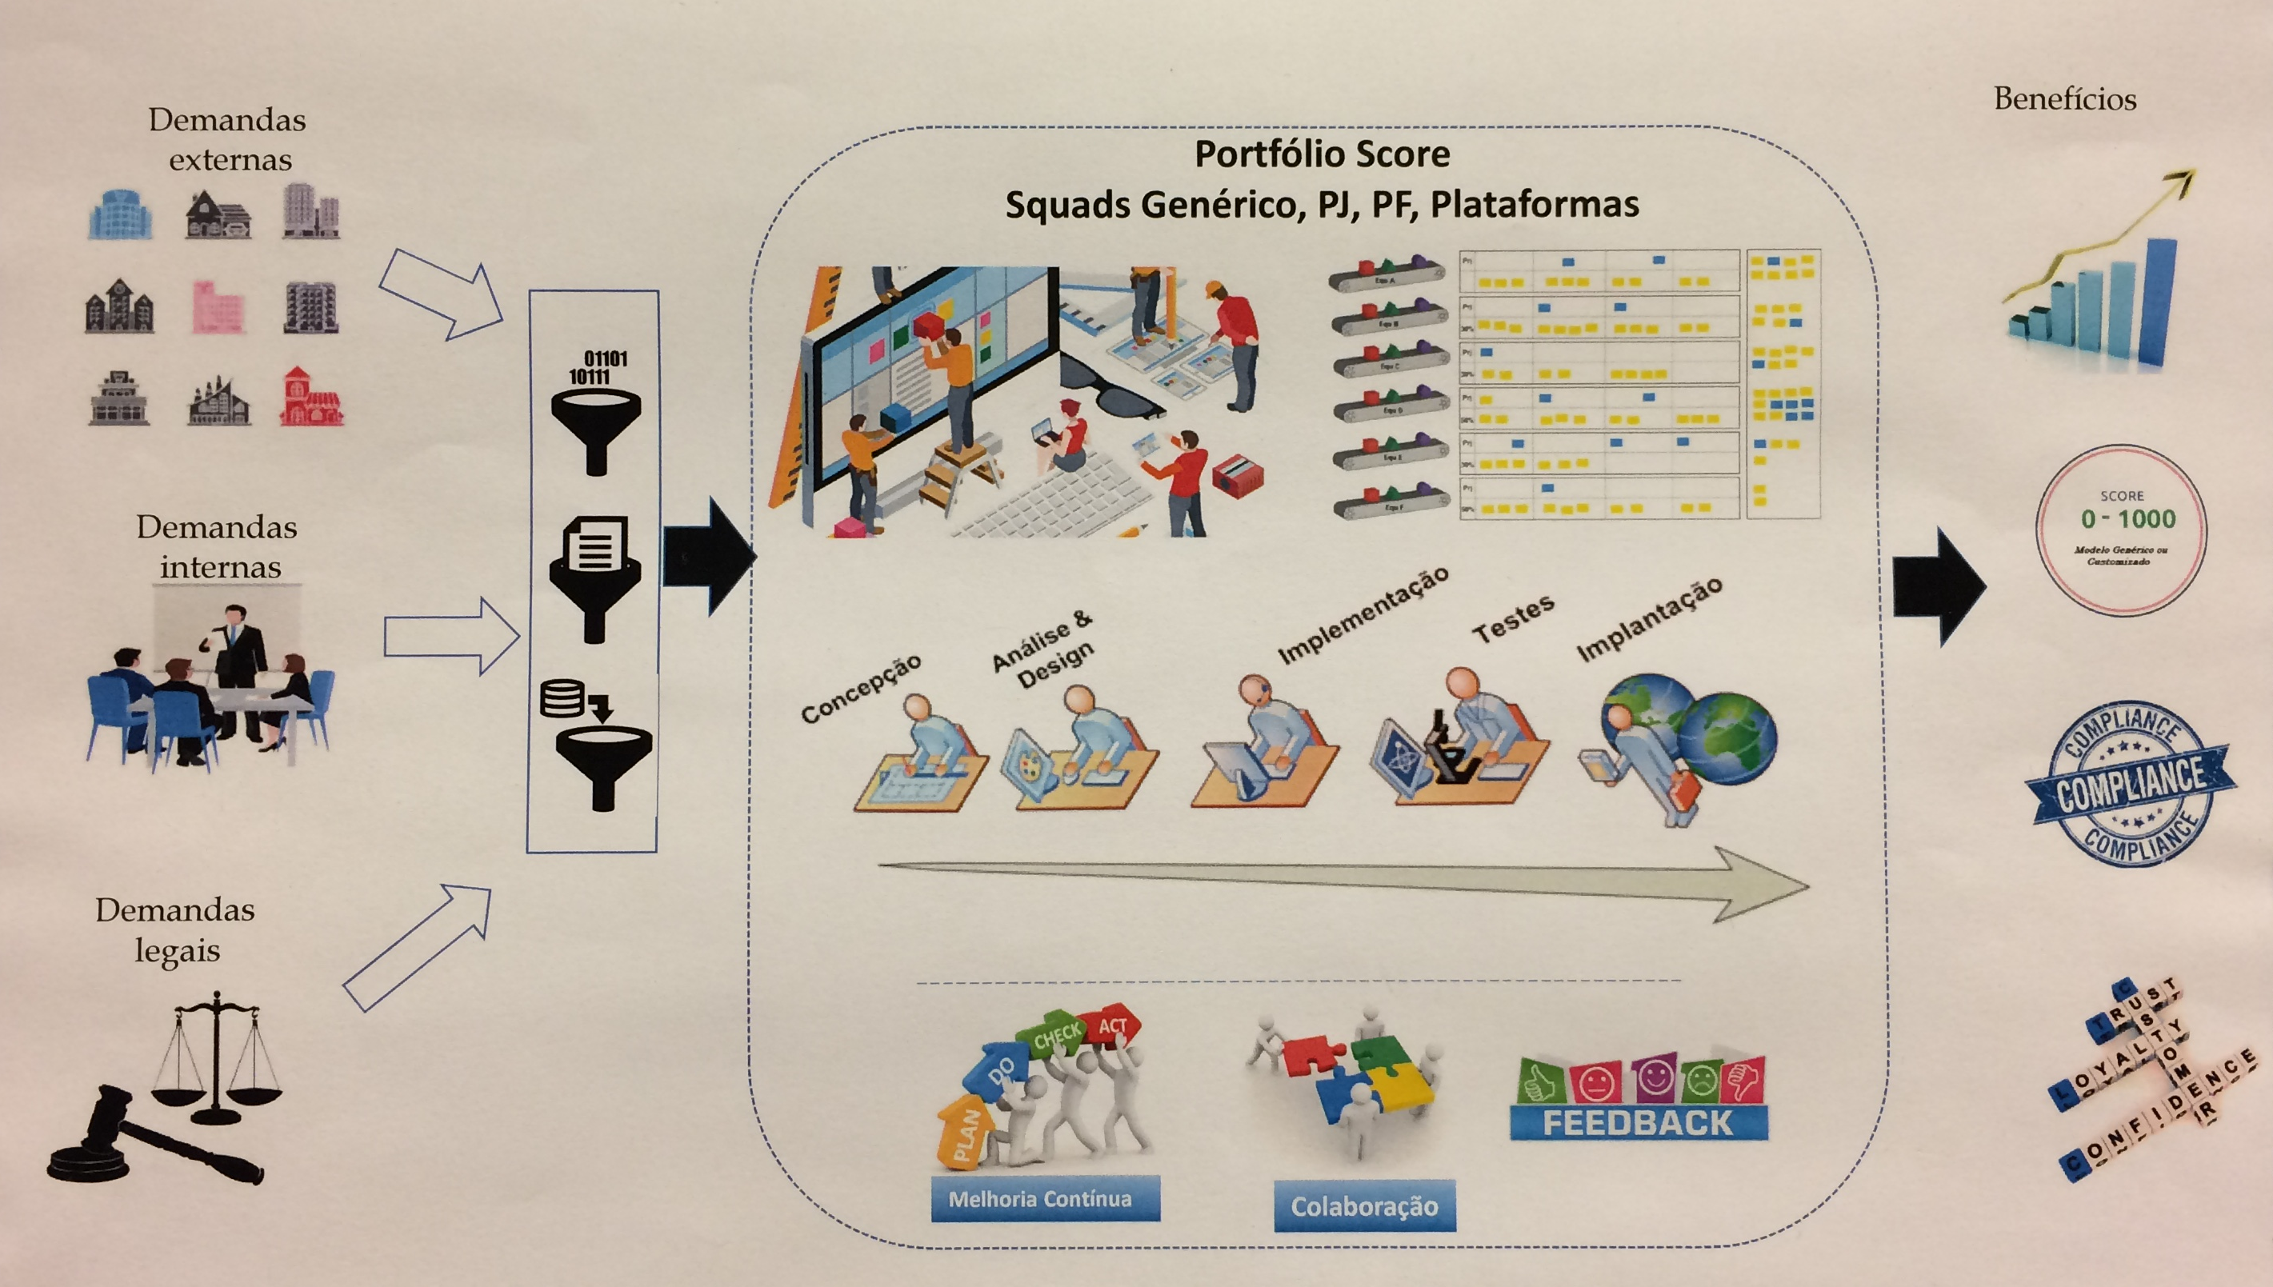
What have we changed here?

Slide 9
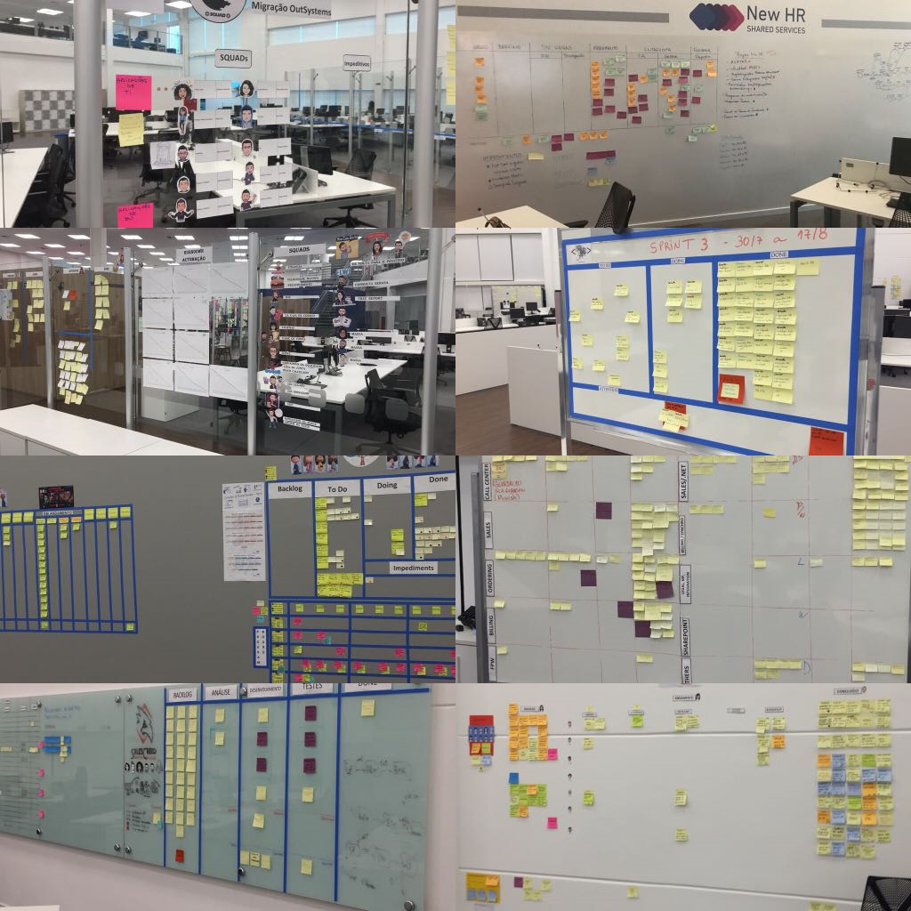
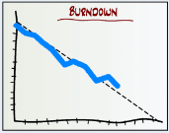
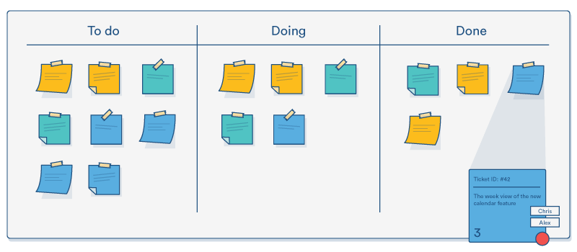
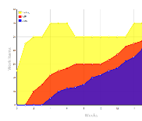
What changes in the process?
Scrum
Burndown
OR
Kanban
CFD

Slide 10

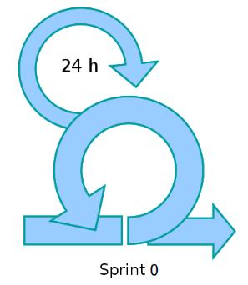
Sprint 0 – release planning/roadmap
Product Backlog Refinement/prioritization
Technical Strategy
“DoD - Definition of Done”
Formal agreements: Audit, Compliance, Risk, GTI, etc
Sec. Assessment
Demand information
Analysis of PSA(Project Security Assessment) by GSO
Result of Inception (where applicable)
5 DAYS
Participants : Facilitator / Scrum Master / Product Owner / TI (Dev/ARQ/Infra/ QS) /
Supplier / GSO, Internal audit, Risks, Compliance, others

Slide 11
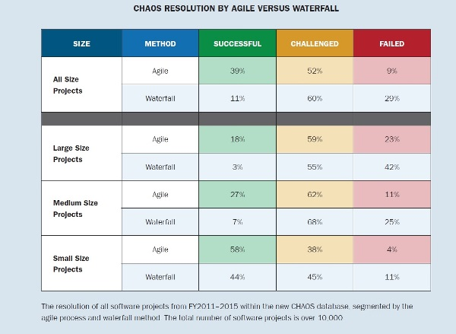
Some numbers…
Source: Standish Group (https://www.infoq.com/articles/standish-chaos-2015)

Slide 12
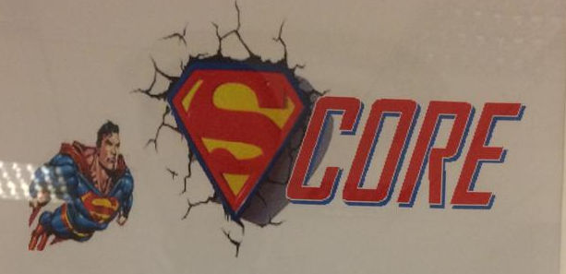


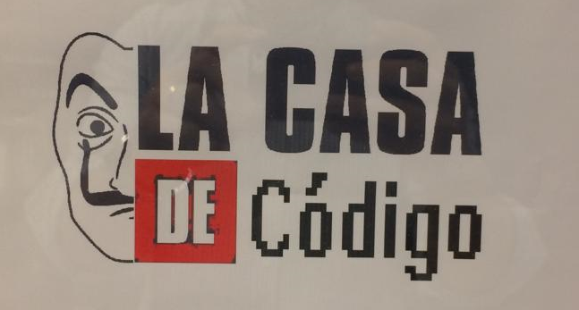
Lead Time – end to end
Backlog
Kick off
Planning
Development
Quality
Assurance
Client Validation
Production
Evolution
Squad
Waterfall
Agile
107 days
38 days
65%
Squad
Waterfall
Agile
80 days
30 days
62%

